Slide 1
2D game movement and control
Course : 2D Game Programming
Effective Period : September 2018

Slide 2
These slides have been adapted from: Pereira, V. (2014). Learning Unity 2D Game Development by Example, Packt Publishing, Inc. San Francisco. ISBN: 9781783559046 Chapter 5
Acknowledgement

Slide 3
Learning Objectives
LO 1 : Create 2D game for PC platform
LO 2 : Apply best practices of 2D game development
LO 3 : Design 2D game for PC platform

Slide 4
What's Your Input?
We will discuss
Input versus output
Input types
Output types
Input Manager
Input detection
Buttons
Game controls

Slide 5
Input in games
Input may not seem a very important part of a game at first glance, but in fact it is very important, as input in games involves how the player will interact with the game. All the controls in our game, such as moving, special abilities, and so forth, depend on what controls and game mechanics we would like in our game and the way we would like them to function.

Slide 6
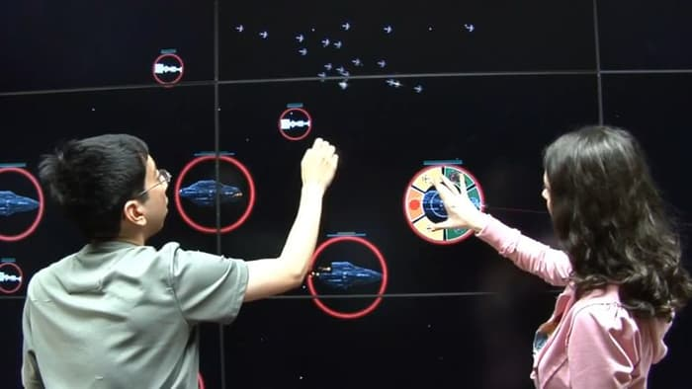

Input in games
Image source: www.gizmag.com
Image source: www.firmology.com

Slide 7
Output in games
Output is the direct opposite of input; it provides the necessary information to the player. However, output is just as essential to a game as input. It provides feedback to the player, letting them know how they are doing. Output lets the player know whether they have done an action correctly or they have done something wrong, how they have performed, and their progression in the form of goals/missions/objectives.
Without feedback, a player would feel lost. The player would potentially see the game as being unclear, buggy, or even broken. For certain types of games, output forms the heart of the game.

Slide 8
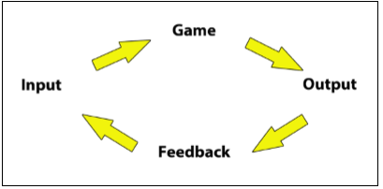
Output in games
Image source:
Pereira, V. (2014). Learning Unity 2D Game Development by Example. Packt Publishing, Inc. San Francisco.

Slide 9
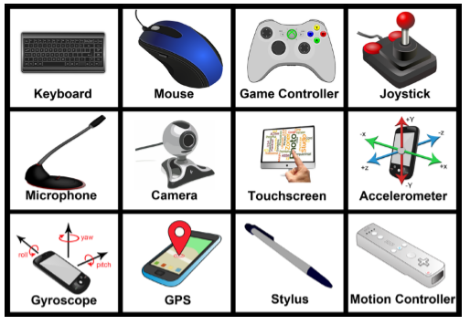
Input Types
There are many different input types that we can utilize in our games. These various input types can form part of the exciting features that our games have to offer.
Image source:
Pereira, V. (2014). Learning Unity 2D Game Development by Example. Packt Publishing, Inc. San Francisco.

Slide 10
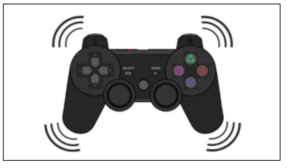
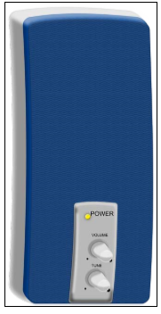
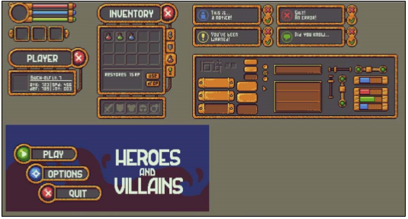
Output types
Visual output
Audio output
Controller vibration
Image source:
Pereira, V. (2014). Learning Unity 2D Game Development by Example. Packt Publishing, Inc. San Francisco.

Slide 11
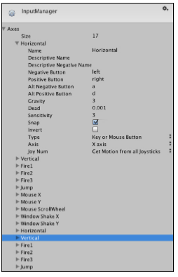
Unity Input Manager
The Input Manager allows us to set up (map) our standard game control configuration for our game, and it has two advantages that are as follows:
The Input Manager allows us to simply and easily use the default set keys in our scripts
The Input Manager allows the players of our games to set the controls to their own configurations.
To configure it, we go to Edit | Project Settings | Input.
Image source:
Pereira, V. (2014). Learning Unity 2D Game Development by Example. Packt Publishing, Inc. San Francisco.

Slide 12
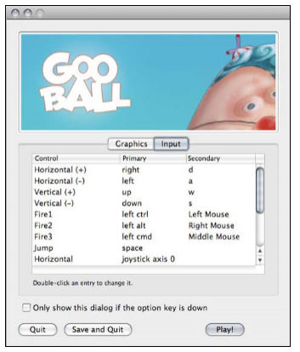
Unity Input Manager
Player can edit their input before playing the game
Image source:
Pereira, V. (2014). Learning Unity 2D Game Development by Example. Packt Publishing, Inc. San Francisco.

Slide 13
Detecting Input
To detect input from the various devices, namely, computers and mobiles (iOS and Android), we will make use of the Unity class named Input with its functions and variables.
For movement-based input, we make use of the Input.GetAxis() function to ensure that movement is smoother and to reduce the size and complexity of the script.
For all other action event buttons, we make use of the Input.GetButton() function. We always call these functions from within the Update() function since they only get reset when the frame updates.
For iOS and Android mobile devices, we can track multiple touch inputs using the Input.touches property. We can also track input via the accelerometer and gyroscope using the properties Input.acceleration and Input.gyro respectively.

Slide 14
Buttons and OnGUI
Usually, the very first input that is required from a player in most games is from buttons on the main menu of a game. Thus, we are now going to create our own buttons using the OnGui function provided by Unity.
The OnGUI function is used for handling GUI events, the creation and the look and functionality of the game's GUI. It is an event function that is part of the well-defined set of callbacks that Unity provides, so it gets called automatically like Start() and Update(). We, therefore, do not call it within another function. OnGUI can be called several times per frame depending on its implementation. It will get called once per GUI event.

Slide 15
GUILayout.Button
function OnGUI() {
if(GUILayout.Button("Button 1", GUILayout.Width(100), GUILayout.Height(100)))
{
Debug.Log("Button 1 clicked!");
}
if(GUILayout.Button("Button 2", GUILayout.Width(100), GUILayout. Height(100)))
{
Debug.Log("Button 2 clicked!");
}
}

Slide 16
Game controls
we learned how to move a character left and right using input from our keyboard. However, many games make use of virtual controls instead, which are onscreen controls. Therefore, it is worth creating our own game controls onscreen as opposed to entering input on the keyboard.
To do this, we will make use of sprites for the HUD to display the virtual controls and raycasting to detect when the player touches a control for input.

Slide 17
Raycasting
Raycasting is a query on the scene that returns objects that intersect with a given ray (which is a point in space with a direction). If we cast a ray from the main 2D camera in a straight line into the screen (specified by where the player is touching/clicking), we can then check if a collider has been hit.
If a collider has been hit, then we can check the name of the collider's GameObject. Depending on which GameObject has been hit, we can call the appropriate script to move the character GameObject in the corresponding direction.

Slide 18
Raycasting
Let’s Start !!
We download some public domain art from the following URL: http://freeartsprites.com/free-art/Space-Pack/
Splice the image so that each control has been separated and the left, right, up, and down portions have become separate sprites.

Slide 19
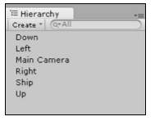
Raycasting
Convert each of these into a GameObject, and name them so that they are identical to the following screenshot:
It is essential that they match as we will be calling those exact names in the script.
Image source:
Pereira, V. (2014). Learning Unity 2D Game Development by Example. Packt Publishing, Inc. San Francisco.

Slide 20
Raycasting
Add a Box Collider 2D to each control by going to Add Component | Physics 2D | Box Collider 2D.
We are going to check if a collider overlaps a point using Physics2D.OverlapPoint.
Assign the following script to the right control

Slide 21
Raycasting
var platform : RuntimePlatform = Application.platform;
function checkTouch(pos) {
var wp : Vector3 = Camera.main.ScreenToWorldPoint(pos);
var touchPos : Vector2 = new Vector2(wp.x, wp.y);
var h
if(hit){
control = hit.transform.name;
print(""+control);
if (control == "right") {
move();
}
}
}
it = Physics2D.OverlapPoint(touchPos);

Slide 22
Raycasting
function Update() {
if(platform == RuntimePlatform.Android || platform == RuntimePlatform.IPhonePlayer)
{
if(Input.touchCount > 0) {
if(Input.GetTouch(0).phase == TouchPhase.Began){
checkTouch(Input.GetTouch(0).position);
}
}
}else if(platform == RuntimePlatform.WindowsEditor){
if(Input.GetMouseButtonDown(0)) {
checkTouch(Input.mousePosition);
}
}
}

Slide 23
Raycasting
function move() {
ship = GameObject.Find("Ship");
ship.transform.Translate(Vector3.right * (Time.deltaTime*10),
Camera.main.transform);
}

Slide 24
Raycasting
We will use the ship we used in the previous chapter.
When we click on play, the ship should move in the corresponding direction.
We copy the script three more times and use exactly the same script that we used before for the left, up, and down controls by simply replacing the direction: ship.transform.Translate(Vector3.right * (Time. deltaTime*10), Camera.main.transform);
We build our code by going to Build | Build All and click on the play button in Unity to test it.

Slide 25
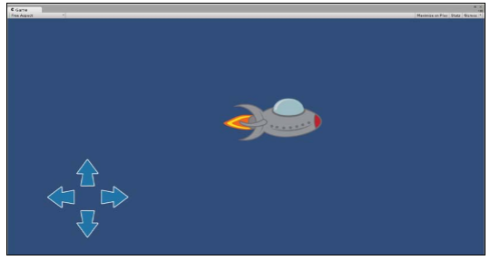
Raycasting
Image source:
Pereira, V. (2014). Learning Unity 2D Game Development by Example. Packt Publishing, Inc. San Francisco.

Slide 26
Discussion
What is your favourite game input?
What is the most unique game input that you have known?
Is there another alternative of game output aside of what we have discussed?

Slide 27
Exercises
What is the input of your game?
Create a creative input that may or may not be used in your game.

Slide 28
References
Freeman, J. (2015). Unity’s New 2D Workflow
Vidyasagar. (2014. Unity and C#: Game Loop.CodeProject
Pereira, V. (2014). Learning Unity 2D Game Development by Example. Packt Publishing, Inc. San Francisco. ISBN: 9781783559046

